Slide 1
Chap#5
Understanding Requirements

Slide 2
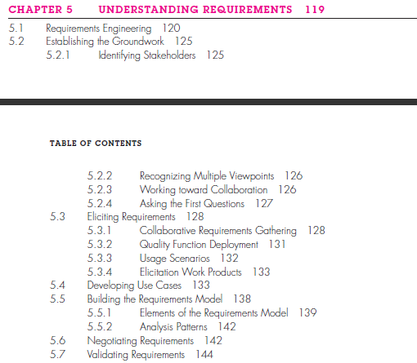

Slide 3
5.1 Requirements Engineering
Clear understanding of what is needed. Attempt to understand requirements in detail.
Requirements engineering establishes a solid base for design and construction. Without it, the resulting software has a high probability of not meeting customer’s needs.
Requirements engineering provides the appropriate mechanism for understanding what the customer wants, analyzing need, assessing feasibility, negotiating a reasonable solution, specifying the solution unambiguously, validating the specification, and managing the requirements as they are transformed into an operational system.
It encompasses seven distinct tasks: inception(need identification), elicitation(Problems of scope, Problems of understanding, Problems of volatility), elaboration(refined during elaboration), negotiation(discuss conflicts in priority), specification(written document, graphical models, formal mathematical model, scenarios, prototype), validation(products produced as a consequence of requirements), and management(changes to requirements at any time).
Notes:
volatility. The requirements change over time.

Slide 4
5.2 Establishing the Groundwork
5.2.1 Identifying Stakeholders
“anyone who benefits in a direct or indirect way from the system which is being developed.”
5.2.2 Recognizing Multiple Viewpoints
“Put three stakeholders in a room and ask them what kind of system they want. You’re likely to get four or more different opinions.”
5.2.3 Working toward Collaboration
customers must collaborate among themselves and with software engineering practitioners if a successful system is to result.
5.2.4 Asking the First Questions
Questions help to identify all stakeholders who will have interest in the software to be built. In addition, the questions identify the measurable benefit of a successful implementation and possible alternatives. Better understanding of the problem and allows the customer to voice his or her perceptions about a solution.

Slide 5
5.3 Eliciting Requirements
Requirements elicitation (also called requirements gathering) combines elements of problem solving, elaboration, negotiation, and specification.
5.3.1 Collaborative Requirements Gathering
Meetings, Rules defined, agenda discussion, facilitator(meeting control), mechanism to be used.
goal is to identify the problem, propose elements of the solution, negotiate different approaches, and specify a preliminary set of solution requirements in an atmosphere that is conducive to the accomplishment of the goal.
5.3.2 Quality Function Deployment
Quality function deployment (QFD) is a quality management technique that translates the needs of the customer into technical requirements for software. QFD “concentrates on maximizing customer satisfaction from the software engineering process”.
QFD identifies three types of requirements: Normal requirements, Expected requirements, Exciting requirements
Notes:
Normal requirements. The objectives and goals that are stated for a product or system during meetings with the customer. If these requirements are present, the customer is satisfied.
Expected requirements. These requirements are implicit to the product or system and may be so fundamental that the customer does not explicitly
state them. Their absence will be a cause for significant dissatisfaction. Examples of expected requirements are: ease of human/machine interaction,
overall operational correctness and reliability, and ease of software installation.
Exciting requirements. These features go beyond the customer’s expectations and prove to be very satisfying when present. For example, software for
a new mobile phone comes with standard features, but is coupled with a set of unexpected capabilities (e.g., multitouch screen, visual voice mail) that delight every user of the product.

Slide 6
Continue…
5.3.3 Usage Scenarios
Overall vision of system functions and features begins to materialize.
how these functions and features will be used by different classes of end users. To accomplish this, developers and users can create a set of scenarios that identify a thread of usage for the system to be constructed.
The scenarios, often called use cases , provide a description of how the system will be used.
5.3.4 Elicitation Work Products
Consequence of requirements elicitation will vary depending on the size of the system or product to be built.
statement of need and feasibility, scope, participated in requirements elicitation, system’s technical requirements, constraints, usage scenarios, prototypes developed to better define requirements.

Slide 7
5.4 Developing Use Cases
Use cases are defined from an actor’s point of view. An actor is a role that people (users) or devices play as they interact with the software.
describes the system’s behavior under various conditions as the system responds to a request.
Use Case tells a stylized story about how an end user (playing one of a number of possible roles) interacts with the system under a specific set of circumstances.
Use Case depicts the software or system from the end user’s point of view.(page 136,138)
Define the set of “actors” that will be involved in the story(Different people using system).
After careful review of requirements, the software for the control computer requires four different modes (roles) for interaction: programming mode, test mode, monitoring mode, and troubleshooting mode.
Primary actors interact to achieve required system function and derive the intended benefit from the system. They work directly and frequently with the software.
Secondary actors support the system so that primary actors can do their work.

Slide 8
5.5 Building the Requirements Model
The intent of the analysis model is to provide a description of the required informational, functional, and behavioral domains for a computer-based system. The model changes dynamically as you learn more about the system to be built.
5.5.1 Elements of the Requirements Model (page 140)
Scenario-based elements The system is described from the user’s point of view using a scenario-based approach.
Class-based elements Each usage scenario implies a set of objects that are manipulated as an actor interacts with the system. These objects are categorized into classes—a collection of things that have similar attributes and common behaviors.
Behavioral elements Behavioral elements(state) The behavior of a computer-based system can have a profound effect on the design that is chosen and the implementation approach that is applied.
Flow-oriented elements inputs, processing, outputs

Slide 9
5.5.2 Analysis Patterns
These analysis patterns suggest solutions within the application domain that can be reused when modeling many applications.
First, analysis patterns speed up the development of abstract analysis models that capture the main requirements of the concrete problem by providing reusable analysis models with examples as well as a description of advantages and limitations. Second, analysis patterns facilitate the transformation of the analysis model into a design model by suggesting design patterns and reliable solutions for common problems.

